Slide 1


React JS
Unidirectional Data Flow UI Library

Slide 2


Slide 3
MENU
High Level
Technical
Gotchas
Setup
Advanced
Code
Flux

Slide 4
High Level
React v18
Open-Source Library, by Facebook
Just the View in MVC
Has dropped IE support (possible with polyfills till v17)
Component Composition
Ecosystem
Flux
Relay & GraphQL
DevTools, SourceMaps, Debugging, …
Notes:
Used at Instagram, Netflix, Paypal, Imgur, Feedly, ...

Slide 5
Not a Framework
Http Calls? Fetch, Axion or Superagent
Routing? React-Router, …
Component Suite? React-Bootstrap, MUI, Ant Design, …
State Management? Redux, MobX, …
Other? React Intl, React DnD, React Hook Form, …

Slide 6
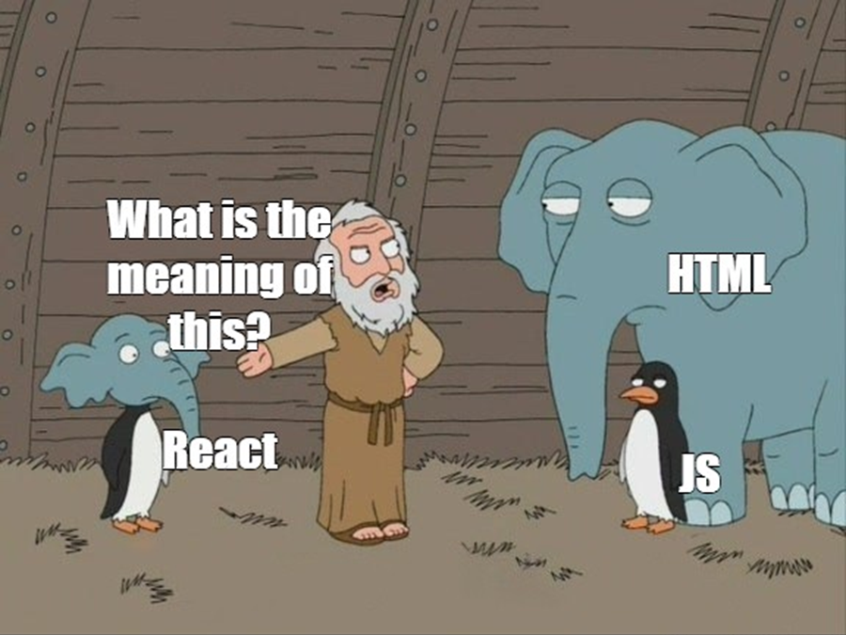
Technical
Plain JavaScript
ES6, TypeScript, ... possible
Optionally with JSX / TSX: Composable HTML in JavaScript

Slide 7

Technical
"This is my state, you render it"
Declarative
One Way Data Flow
Virtual DOM

Slide 8

Gotchas
(or props)

Slide 9
Gotchas
class → className & for → htmlFor
Inline CSS: style={{maxWidth: 100}}
Use map & “key” prop for lists
SyntheticEvent
e.preventDefault()
e.stopPropagation()
Forms: Consider Formik

Slide 10
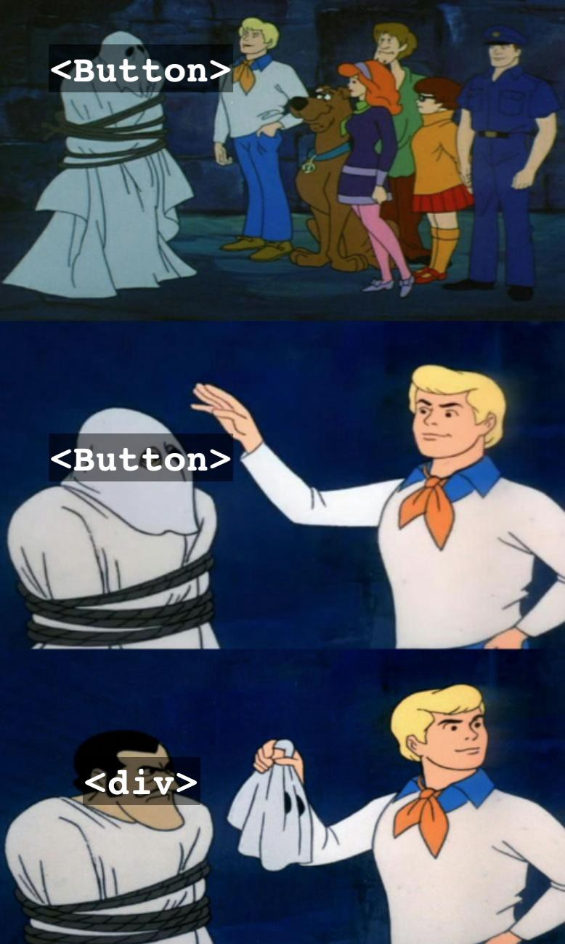
Setup
0-Basic: Hello React
Load React Libraries
Attach React to a DOM Element

Slide 11

Setup
1-Create-React-App:
React-scripts
SASS (npm install sass)
TypeScript / Flow
Async/Await
…
Notes:
CLI: npx create-react-app my-app --template typescript

Slide 12
Advanced
Context: Themes, User Language, …
Higher Order Components: <EnableDisabledComponent />
Refs: focus, 3rd party libraries, …
Portals: Apply React Partially
<Profiler><MeasureMe /></Profiler>
Flow vs TypeScript
<React.StrictMode><App /></React.StrictMode>
<div dangerouslySetInnerHTML={{__html: data}} />
Hooks! Hooks! Hooks!!!
Notes:
HOC: Apply a theme, … Example: Wrap all components in a <EnableDisabledComponent enabled={true} />

Slide 13
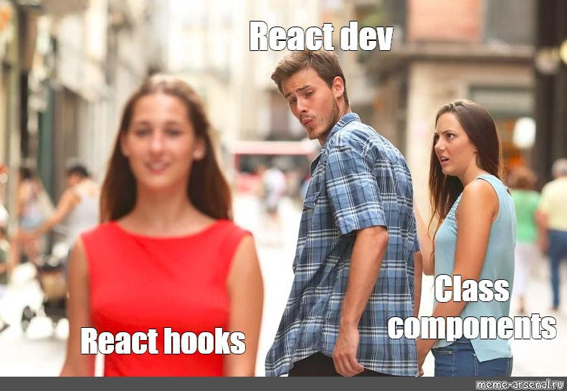
Hooks

Slide 14
Hooks
Do NOT Branch before any hook
Starts with “use” (convention)
useState
useEffect
useContext
useReducer
useLocalStorage
useYourCustomThingie
Notes:
https://usehooks-ts.com/

Slide 15
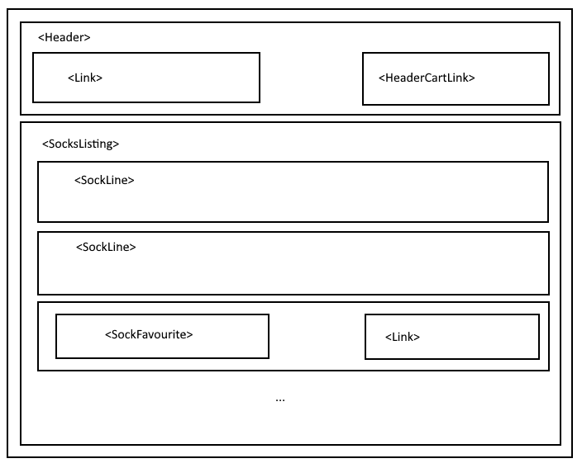
React socks

Slide 16
resources
React Cheat Sheet
React TypeScript Cheat Sheet

Slide 17
Questions?

Slide 18
Next
12/9 : Vue
21/9 : GarbageCollection .NET vs Java
26/9 : RXJS

